Slide 1
Computer Vision for Real-Time Monkeypox Diagnosis on Embedded Systems
Jacob M. Delgado López
Ricardo A. Morell
Sebastian O. Espinosa

Slide 2
TRIGGER WARNING!!!
Gross disease lesions will be visible!!!

Slide 3
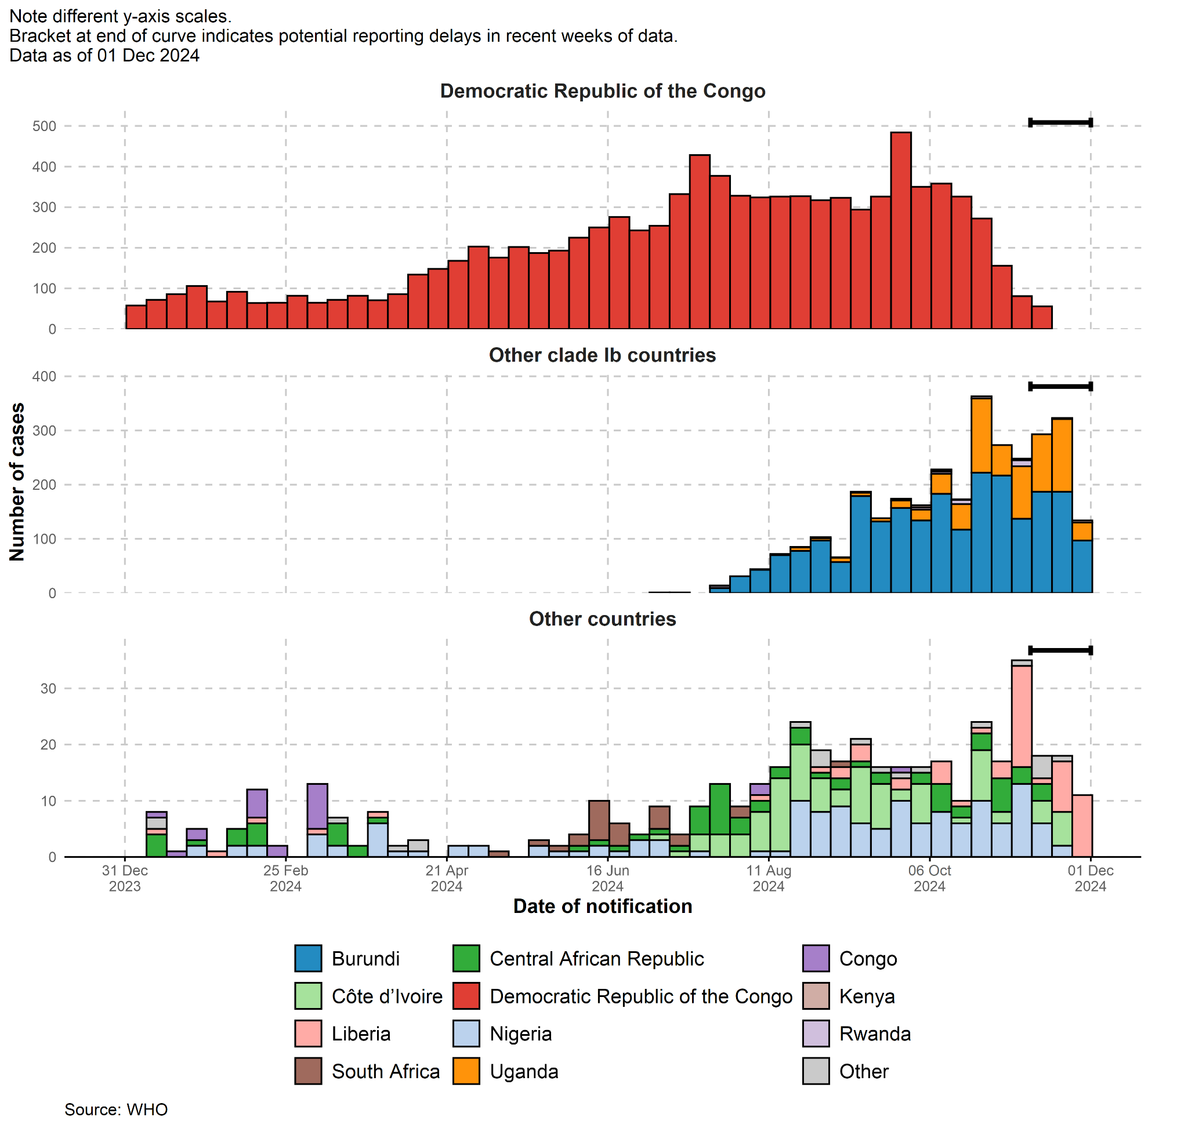
Motivation
Outbreak of Monkeypox cases since 2022.
PCR and blood tests issues.
Need for a diagnostics tools in low-resourced areas.
Adapted from [1]
Notes:
"In recent years, the resurgence of monkeypox, or Mpox, has posed a significant public health challenge. There’s been an exponential increase in outbreaks across multiple countries, highlighting the need for rapid, accurate diagnosis to control the spread of the disease. Currently, the most reliable diagnostic tools include PCR tests and blood tests, which are considered the standard. While effective, these methods are far from ideal.
For starters, the cost of a PCR test can run up to $175 per test, making them inaccessible for many, especially in low-income regions.
Results can take anywhere from 3 to 7 days, delaying treatment and containment efforts. Finally, their accuracy varies a lot. Depending on when the sample is collected in the disease's progression and how well the protocol is followed can increase the likelihood of false positives or negatives.
For regions without sufficient healthcare infrastructure, these barriers make timely and effective diagnosis nearly impossible, putting vulnerable populations at greater risk."

Slide 4
Objectives
Identify Relevant Dataset
Identify Lightweight Pre-trained Model
Model Development and Accuracy
Model Optimization for Deployment
Web Application
Wifi Access Point (AP) Hotspot
Notes:
To complete this project and make our solution a viable option, we needed to accomplish the following objectives:
We needed a relevant dataset that contained monkeypox images and images of similar skin diseases like chickenpox to train our model. This dataset had to have a high rating and been used in previous papers to attribute its credibility.
We needed to decide on a lightweight model that could work on mobile devices. It also needed to be pre-trained to ease the transition for identifying monkeypox images
Once we completed the first two objectives, we would begin working on training the model with the dataset looking for the best accuracy and precision that we could.
To deploy the trained model on the device, we would need to optimize and, specifically compress the model so it can run properly on devices with limited computational power and memory
The final objectives relate to the integration and accessibility between the model, the device that the model was deployed on and the user. For this we need to create a web application where the users can upload an image and receive the prediction of the model as a result
We identified that we could enable a Wifi hotspot on the edge device so that any device with wifi capabilities can connect to it.

Slide 5

Solution Approach
A machine learning alternative that analyzes skin lesion images for Monkeypox diagnosis.
Compressed model deployed on the Jetson Orin Nano for real-time, on-device analysis.
Compatible with images captured via phone or standard cameras.
Rapid, reliable diagnosis tailored for low-resource settings
Adapted from [2]
Notes:
So what specifically is our solution? We want to provide a machine learning alternative that can analyze images taken with a phone camera and identifies Monkeypox.
For this, we compressed a model on whats called a Jetson Orin Nano which is a small embedded device made by Nvidia.
The solution will be a rapid, reliable diagnosis that can be used by simply having a battery connected to the Jetson.

Slide 6
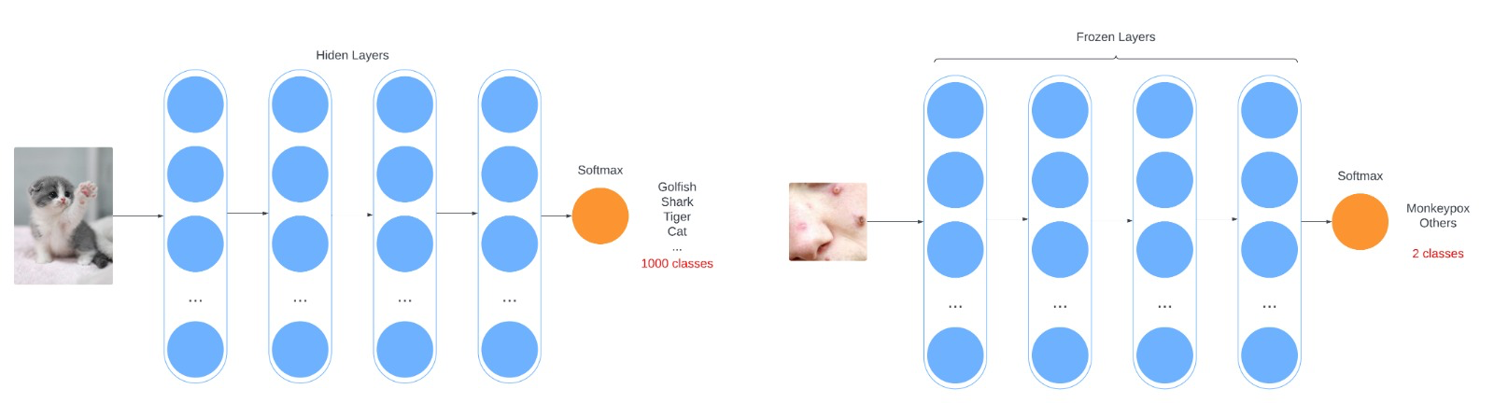
Solution Approach
MobileNet V2 Model
Made for mobile devices and embedded systems
Fig. 1.1 Before Transfer Learning
Fig. 1.2 After Transfer Learning
Notes:
The model we decided to use for the project was the MobileNet Version 2 model. Its a very small scaled model pre-trained by google and as the name suggests, it can be used for mobile devices and embedded systems due to its small size.
This ai model also uses image classification, which is what we need to identify monkeypox skin lesions through pictures AND it can already identify multiple kinds of images such as cat, dogs, flower etc.
We took its logic to identify images and applied transfer learning to it. What transfer learning does is maintain all the internal logic the model uses to identify an image, while only training the input, to take images related to skin diseases and the output, so the result is only a probability of the image being monkeypox or not.

Slide 7
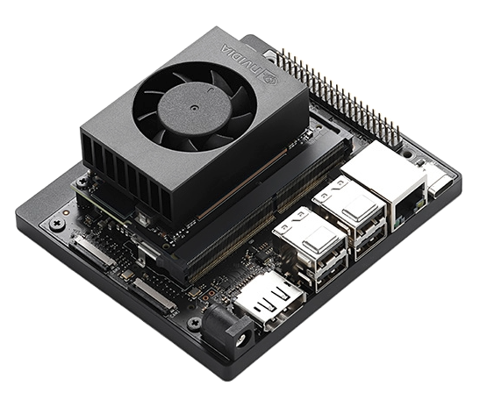
Solution Approach
Jetson Orin Nano
Integrated GPU
Wi-Fi AP Hotspot
Adapted from [3]
Notes:
What is the jetson orin nano
Its an nvidia edge device
Include very short description of what is an embedded system
Why we chose Jetson
Talk about the integrated gpu and benefits
Wi-fi AP Hotspot, what it does and why we want it

Slide 8
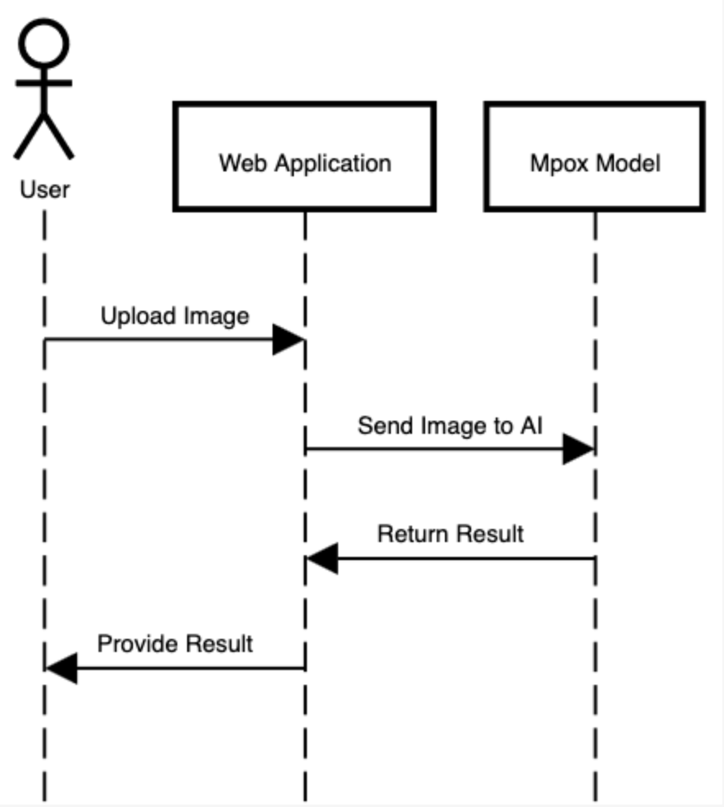
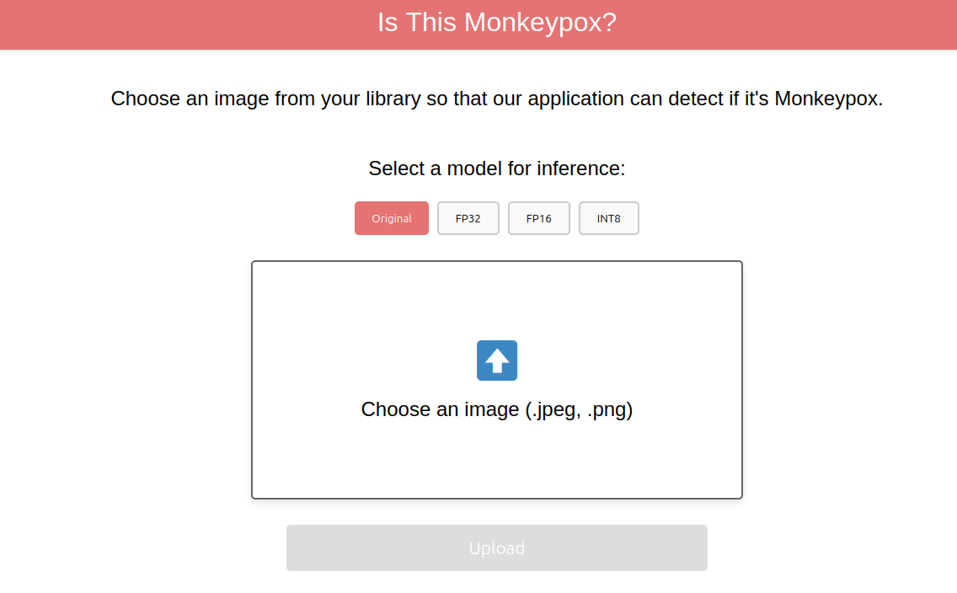
Solution Approach
Web Application running in jetson
Accessible from multiple devices
Fig. 2 Web App Landing Page
Fig. 3 UML Diagram
Notes:
The purpose of the web application is to allow an user to upload an image, have the model process the image and return the prediction to the user
Web application created with HTML and Javascript for basic functionality
The Web application is deployed from the jetson
Any device can connect to the jetsons Wifi hotspot and access the web application
Multiple devices can connect and run simultaneously

Slide 9
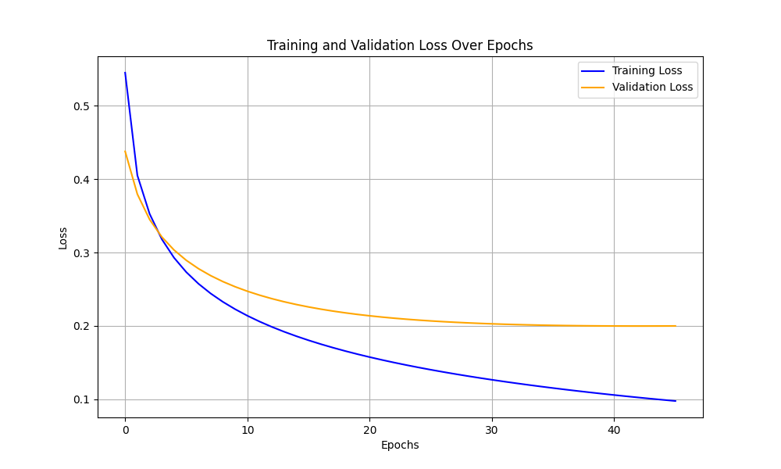
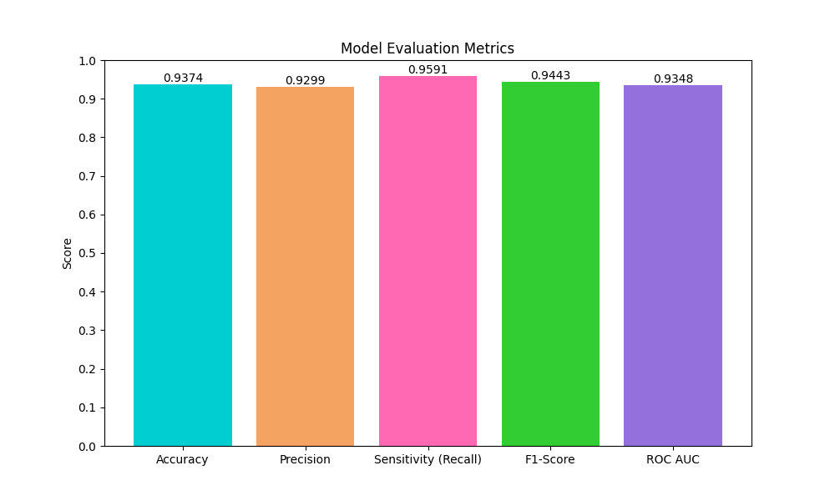
Results
Fig. 4 Training Loss Function Graph
Fig. 5 Post-Training Metrics
Notes:
Talk about that there was no overfitting using k-fold cross validation. Also using early stopping (callback) and model-checkpoint (callback).
Maybe explain how both of these two features work and how they helped.
Mention that having a small dataset required to do these features, still its always a good thing to have.

Slide 10

Results
AP Mode
Nmcli (Network Manager Controller)
Systemctl (System & Service Manager)
Adapted from [4]
Notes:
Used nmcli to create a setup a new wifi hotspot.
This creates the network for the Jetson and also sets the ap mode for the device.
You can set your own password and network name.
Once done you can check your connection and see all the host and ports that are opened. Typically, 192.168.1.x and port 5000.
Using systemctl you can create a service that runs once the system boots up and initiate both the ap mode and then the web server.

Slide 11
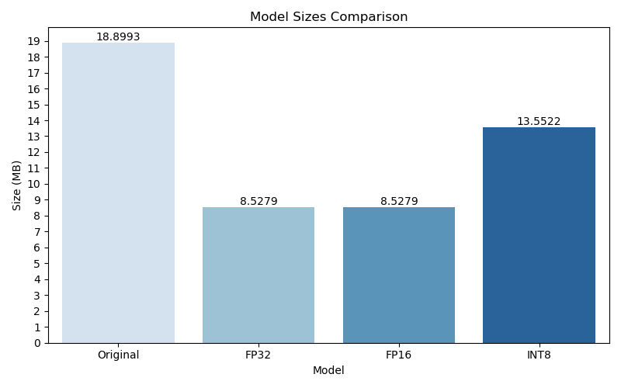
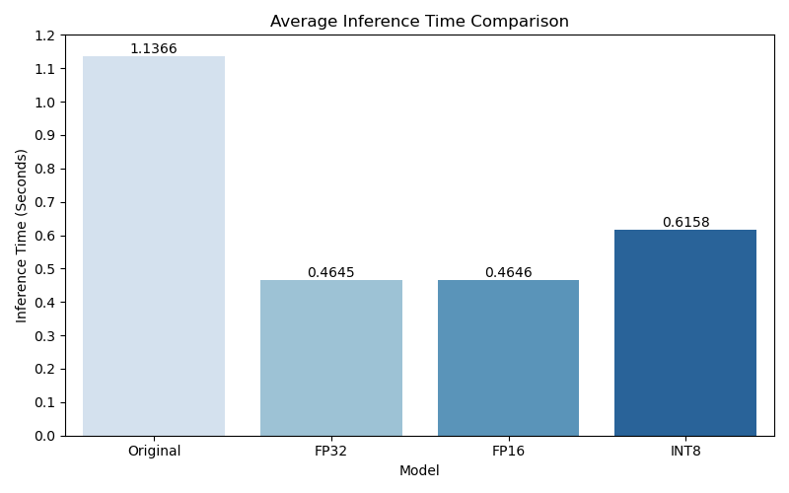
Results
Fig. 6 Model Sizes
Fig. 7 Average Ingerence Times

Slide 12
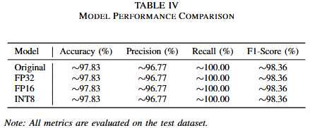
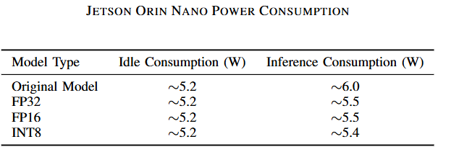
Results
Fig. 8 Models Performances
Fig. 9 Models Power Consumption

Slide 13
Conclusions
Achieved balanced metrics
Improved performance and reduced power
Effective for real-world diagnostics

Slide 14

Demo

Slide 15
Q&A
Thank you for your time!
Any Questions?

Slide 16
References
Redirect Notice. (2024). Google.com. https://www.google.com/url?sa=i&url=https%3A%2F%2Fpib.gov.in%2FPressNoteDetails.aspx%3FNoteId%3D152119%26ModuleId%3D3&psig=AOvVaw0EEtR-glQ1iP93jhnGZNIo&ust=1734043224785000&source=images&cd=vfe&opi=89978449&ved=0CBQQjRxqFwoTCKiHhcfkoIoDFQAAAAAdAAAAABAJ
(2024). Dreamstime.com. https://thumbs.dreamstime.com/b/creative-idea-light-bulb-concept-vector-illustration-cartoon-flat-happy-people-team-holding-big-lamp-lightbulb-creating-new-194669443.jpg
https://cdn.sparkfun.com/assets/parts/2/1/9/6/0/NVIDIA-JetsonOrin-3QTR-Front-Left-_1_.jpg
(2024). Freepik.com. https://img.freepik.com/premium-vector/3d-realistic-yellow-wifi-icon-yellow-color-cartoon-minimal-style-online-communication-concept_550395-1530.jpg

